Slide 1
You learn when you wright. You write when you learn.
But what exactly is writing?

Slide 2
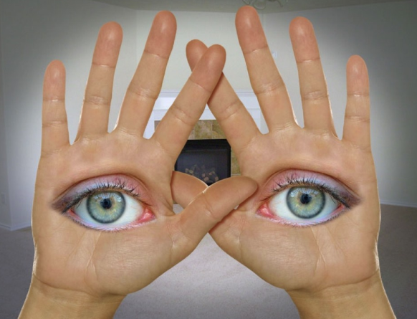
Head : Hand : Eye …. Strong learning
Learn when you write.
Write when you learn.
Switches “ON” your brain.

Slide 3
Writing is more than just English text.
Prose
Poetry
Essay
Narrative
Dot points

Slide 4
Writing is diagrams

Slide 5

Writing is circuits and symbols

Slide 6
Writing is pictures (Visual literacy)

Slide 7
Writing is drawing

Slide 8
Writing is graphics

Slide 9
Writing is graphs

Slide 10
Writing is mathematics

Slide 11
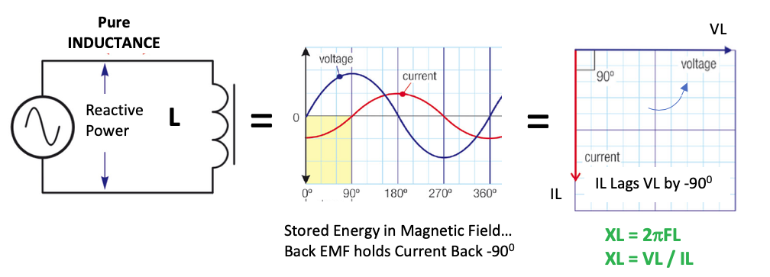
Writing is algebra

Slide 12
Writing is geometry

Slide 13
Writing is the physics modeling system! Because we can’t afford the time and resources to do this!

Slide 14


Learning in AC is mostly through; Hand : Head : Eye:

